Slide 1
Chainshot final project
Russian Roulette
Contributors: Shivali, Daniel, Dilan, chris

Slide 2

Random Number Generation Problems & solution
Many smart contract games use global block values to generate random numbers (timestamp, coinbase, difficulty, gaslimit). The main issue with this is that these examples can manipulated by the miner, which affects the end user of the game.
Chainlink found a solution to this problem by creating random numbers in smart contracts through their VRF(Verifiable Random Function).
Chainlink’s VRF process ensures that results cannot be tampered with or manipulated by anyone. This includes oracle operators, miners, users, and smart contract developers.
CHAINLINK VRF REQUEST
Request Randomness from Chainlink VRF Oracle
Generates Random Number w/ Cryptographic Proof
Proof is published & verified on Chain
Randomness is fulfilled and can be consumed by applications

Slide 3
A brief Overview of our game
Starting/Joining
Each game is initiated by the first player. Player 1 pays a fixed amount to start a game.
Once the game is started, the remaining 5 players can join the game (currently require 6 players)
Once all the players have joined, the contract reaches out to chainlink VRF to get the random numbers that will be used by the game.
Game Mechanics
1. Each round will start with a bullet being loaded into the chamber( the bullet will be the Chainlink random number)
2. Each player will be assigned a number (0-5) and will take turns pulling the trigger.
3. If the player's position in each round matches the VRF random number, then that player is eliminated, and another round starts.
4. There will be a total of 5 Chainlink requests per game (1 per round).
5. Last player standing takes home the prize.

Slide 4
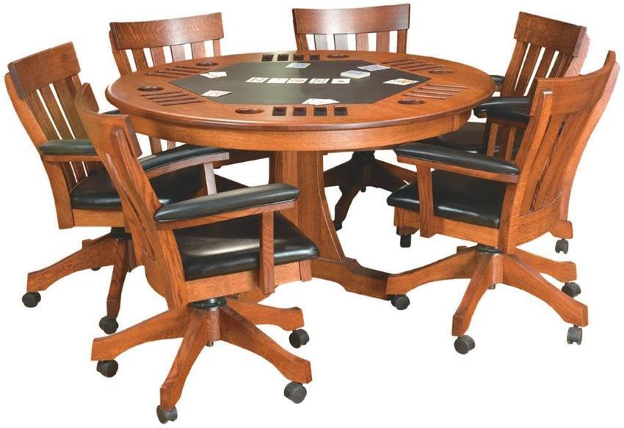
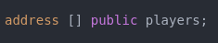
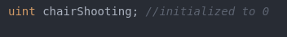





Indexed by

Slide 6
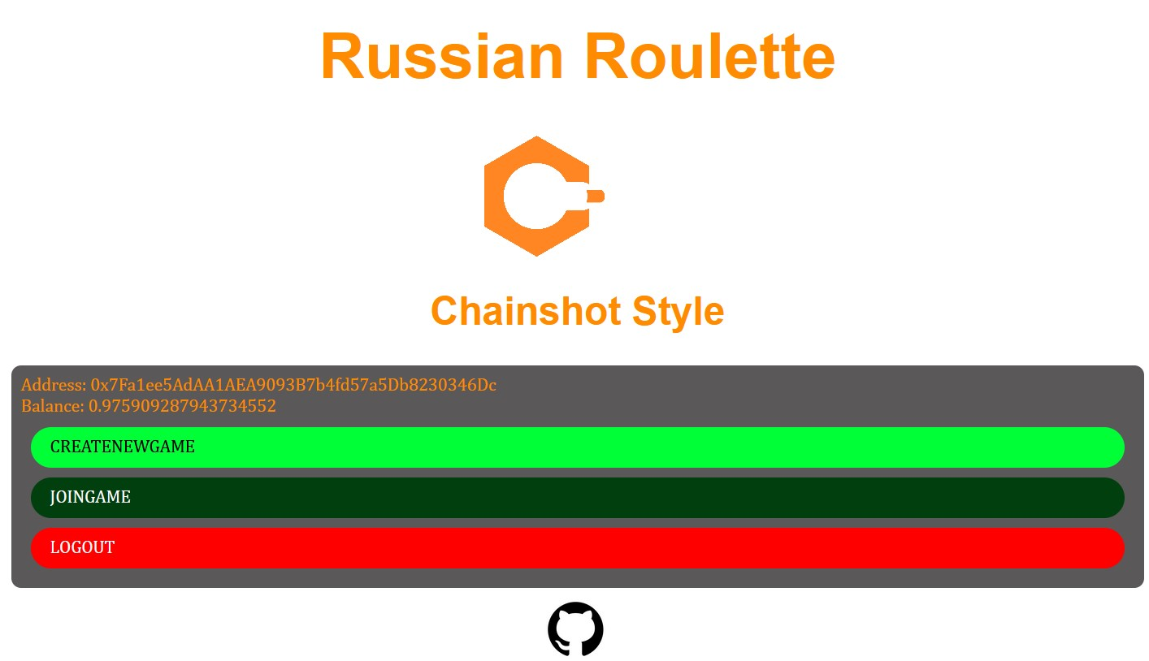

Slide 7
Future Improvements
Multiple games running at the same time.
Different game modes, such as 3,4,5 player games, 50/50 games, etc.
Incorporating NFT’s through airdrops as well as collaborating with other NFT drops.
Improving our front end for a better user experience.

